Slide 1


Probability and Uncertainty
06
PART I · FOUNDATIONS OF DATA
CHAPTER 6 · WEEK 3
Data Science — From Foundations to Intelligent Systems
LECTURER
Dr. Mustafa Hameed
THE ISLAMIA UNIVERSITY OF BAHAWALPUR
Bahawalpur, Pakistan
Department of Information Technology · BSIT · Fall 2026
Notes:
Chapter 6: Probability and Uncertainty. Part 1 — Foundations of Data. Week 3: Describing data; probability. Handout pages 35–42.

Slide 2

Where this chapter sits
THE COURSE
PART I
PART II
PART III
PART IV
PART V
PART VI
1
2
3
4
5
6
7
8
9
10
11
12
13
14
15
16
17
18
19
20
21
22
23
24
25
26
27
28
29
30
31
32
Probability and Uncertainty
BUILDS ON
USED LATER IN
Ch 5 Describing Data: Centre, Spread and Shape
Ch 9 Inferential Statistics
Ch 13 Supervised Learning II: Classification
Ch 14 Model Evaluation and Selection
Ch 26 Data Science for Cybersecurity
Data Science · Chapter 6 · Probability and Uncertainty
Handout p. 35 2
Notes:
Place the chapter. Before you start: Chapter 5 — distributions, mean and standard deviation. Bayes’ theorem here is the direct foundation of naive Bayes in Chapter 13 and of the false-alarm arithmetic in Chapter 14 and Chapter 26.

Slide 3

What you will be able to do
LEARNING OUTCOMES
By the end of this chapter you will be able to:
1
Apply the addition and multiplication rules of probability, and test whether two events are independent.
2
Compute a conditional probability and explain why P(A ∣ B) ≠ P(B ∣ A).
3
Use Bayes’ theorem to update a belief in the light of evidence.
4
Explain the base-rate fallacy and demonstrate it numerically for a rare-event detector.
5
State the Central Limit Theorem and say why it makes inference possible.
Data Science · Chapter 6 · Probability and Uncertainty
Handout p. 35 3
Notes:
Read these out: they are the chapter's contract with the room. Each click adds one.

Slide 4

Vocabulary for this chapter
KEY TERMS
experiment
outcome
event
sample space
independence
mutually exclusive
conditional probability
Bayes’ theorem
prior, likelihood, posterior
base rate
random variable
expected value
Central Limit Theorem
Each term is defined where it first matters — not here.
Data Science · Chapter 6 · Probability and Uncertainty
Handout p. 35 4
Notes:
Do not define these now; they arrive one at a time. This slide is for the students' notes. Terms: experiment; outcome; event; sample space; independence; mutually exclusive; conditional probability; Bayes’ theorem; prior, likelihood, posterior; base rate; random variable; expected value; Central Limit Theorem.

Slide 5

In this chapter
IN THIS CHAPTER
6.1
Why Probability Is the Language of This Course
p. 35 ›
6.2
The Rules
p. 35 ›
6.3
Conditional Probability
p. 36 ›
6.4
Bayes’ Theorem
p. 36 ›
6.5
Random Variables and Expected Value
p. 37 ›
6.6
The Central Limit Theorem
p. 38 ›
Data Science · Chapter 6 · Probability and Uncertainty
Handout pp. 35–42 5
Notes:
The route through the chapter. Each row is a link: click it to jump to that section in the slide show.

Slide 6

Why Probability Is the Language of This Course
KEY IDEA
Every prediction you make is uncertain, and pretending otherwise is the fastest way to lose the trust of the people who use your work. Probability is how uncertainty is written down, compared, and combined. It is also, quite directly, what a classifier outputs: “0.78 probability of failing” is a probability statement, and you cannot interpret it without this chapter.
Data Science · Chapter 6 · Probability and Uncertainty
§6.1 · Handout p. 35 6
Notes:
Say this in your own words first; the slide is the handout's wording.

Slide 7
The Rules
SECTION 2 OF 6
6.2
6.1 Why Probability Is the Language of This Course
6.2 The Rules
6.3 Conditional Probability
6.4 Bayes’ Theorem
6.5 Random Variables and Expected Value
6.6 The Central Limit Theorem
Data Science · Chapter 6
Handout §6.2 7
Notes:
Pause. Name the question this section answers.

Slide 8

Probability
DEFINITION
For an event A, P(A) is a number in [0,1] giving the long-run proportion of occasions on which A happens. P(A)=0 means impossible, P(A)=1 means certain, and P(notA) = 1 − P(A).
Data Science · Chapter 6 · Probability and Uncertainty
§6.2 · Handout p. 35 8
Notes:
Read the box aloud, then ask for an example from the room before moving on.

Slide 9

The Rules
AT A GLANCE
Rule | Formula | In words
Complement | P(Ā) = 1 − P(A) | Either it happens or it does not
Addition (general) | P(A ∪ B) = P(A) + P(B) − P(A ∩ B) | Add, then subtract the double-counted overlap
Addition (exclusive) | P(A ∪ B) = P(A) + P(B) | Valid only when A and B cannot both occur
Multiplication (general) | P(A ∩ B) = P(A) P(B ∣ A) | Chance of A, then chance of B given A happened
Multiplication (independent) | P(A ∩ B) = P(A) P(B) | Valid only when A tells you nothing about B
Data Science · Chapter 6 · Probability and Uncertainty
§6.2 · Handout p. 35 9
Notes:
Do not read the table row by row: pick the row the room is most likely to get wrong and ask why.

Slide 10

The Two Words That Cause Most Errors
WATCH OUT
Mutually exclusive and independent are not the same thing and are almost opposites. Mutually exclusive events cannot co-occur, so knowing one happened tells you the other definitely did not — which is the strongest possible dependence. Two mutually exclusive events with non-zero probability are never independent.
Data Science · Chapter 6 · Probability and Uncertainty
§6.2 · Handout p. 35 10
Notes:
Read the box aloud, then ask for an example from the room before moving on.

Slide 11
Conditional Probability
SECTION 3 OF 6
6.3
6.1 Why Probability Is the Language of This Course
6.2 The Rules
6.3 Conditional Probability
6.4 Bayes’ Theorem
6.5 Random Variables and Expected Value
6.6 The Central Limit Theorem
Data Science · Chapter 6
Handout §6.3 11
Notes:
Pause. Name the question this section answers.

Slide 12
Conditional Probability
DEFINITION
Read as “the probability of A given that B has occurred”. It is the probability of A within the reduced world in which B is true.
Data Science · Chapter 6 · Probability and Uncertainty
§6.3 · Handout p. 36 12
Notes:
Read the box aloud, then ask for an example from the room before moving on.

Slide 13
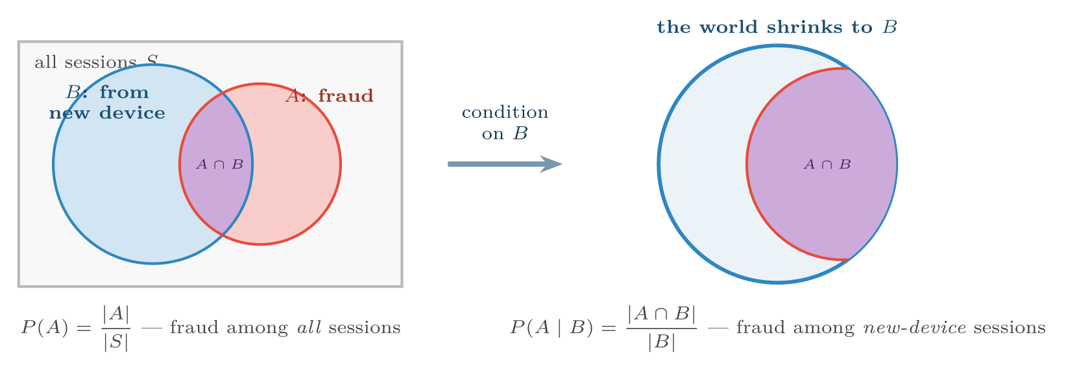
Conditioning shrinks the universe
FIGURE 6.1
P(A) divides the overlap by everything; P(A ∣ B) divides the same overlap by B alone. Because the denominators differ, P(A ∣ B) and P(B ∣ A) are different numbers — confusing them is the base-rate fallacy.
Data Science · Chapter 6 · Probability and Uncertainty
§6.3 · Handout p. 36 13
Notes:
Figure 6.1 (handout p. 36): Conditioning shrinks the universe. P(A) divides the overlap by everything; P(A ∣ B) divides the same overlap by B alone. Because the denominators differ, P(A ∣ B) and P(B ∣ A) are different numbers — confusing them is the base-rate fallacy.

Slide 14
Bayes’ Theorem
SECTION 4 OF 6
6.4
6.1 Why Probability Is the Language of This Course
6.2 The Rules
6.3 Conditional Probability
6.4 Bayes’ Theorem
6.5 Random Variables and Expected Value
6.6 The Central Limit Theorem
Data Science · Chapter 6
Handout §6.4 14
Notes:
Pause. Name the question this section answers.

Slide 15

Bayes’ Theorem
DEFINITION
It converts P(B ∣ A) — which you can usually measure — into P(A ∣ B) — which is usually what you actually want to know.
Data Science · Chapter 6 · Probability and Uncertainty
§6.4 · Handout p. 36 15
Notes:
Read the box aloud, then ask for an example from the room before moving on.

Slide 16

The Base-Rate Fallacy: An Intrusion Detector
WORKED EXAMPLE
An intrusion detection system is tested and found to be excellent:
• It flags 99% of genuine attacks: P(alert ∣ attack) = 0.99.
• It has a 1% false alarm rate: P(alert ∣ normal) = 0.01.
Attacks are rare: 1 session in 10,000 is an attack, so P(attack) = 0.0001.
The alert fires. What is the probability this is a real attack?
Work with a concrete population of 1,000,000 sessions.
• Genuine attacks: 1,000,000 × 0.0001 = 100. Of these, 100 × 0.99 = 99 are flagged.
• Normal sessions: 999,900. Of these, 999,900 × 0.01 = 9,999 are flagged.
Total alerts: 99 + 9,999 = 10,098.
Data Science · Chapter 6 · Probability and Uncertainty
§6.4 · Handout p. 36 16
Notes:
Each click adds one step of the working. Ask for the next number before you reveal it.

Slide 17
The Base-Rate Fallacy: An Intrusion Detector (continued)
WORKED EXAMPLE
Under 1%. A detector that catches 99% of attacks produces alerts that are wrong 99% of the time. Nothing is broken — the arithmetic is simply dominated by the base rate. There are so many more normal sessions that even a 1% error on them swamps the true positives.
Consequences you must remember:
• This is why security teams suffer alert fatigue, and why reducing the false-positive rate matters far more than raising the detection rate.
• To reach P(attack ∣ alert) > 0.5 here, the false alarm rate must fall to about 0.0001 — a hundredfold improvement.
Data Science · Chapter 6 · Probability and Uncertainty
§6.4 · Handout p. 36 17
Notes:
Each click adds one step of the working. Ask for the next number before you reveal it.

Slide 18
The Base-Rate Fallacy: An Intrusion Detector (continued)
WORKED EXAMPLE
• The same arithmetic governs medical screening, plagiarism detection and every rare-event problem you will meet. Chapter 14 formalises it as precision.
Data Science · Chapter 6 · Probability and Uncertainty
§6.4 · Handout p. 36 18
Notes:
Each click adds one step of the working. Ask for the next number before you reveal it.

Slide 19
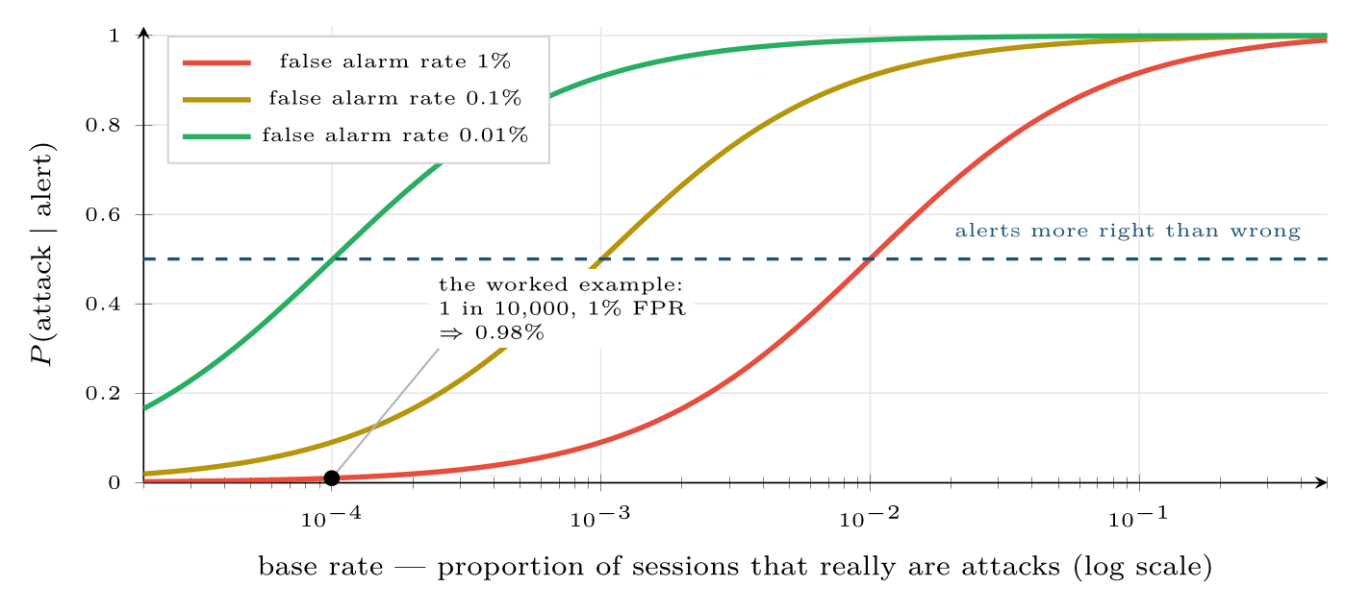
Why rare-event detection is hard
FIGURE 6.2
Detection rate is held at 99% throughout; only the false alarm rate changes. At a base rate of 1 in 10,000 even a 0.1% false alarm rate leaves most alerts wrong. This single figure explains the design of every alerting system in Chapter 26.
Data Science · Chapter 6 · Probability and Uncertainty
§6.4 · Handout p. 36 19
Notes:
Figure 6.2 (handout p. 37): Why rare-event detection is hard. Detection rate is held at 99% throughout; only the false alarm rate changes. At a base rate of 1 in 10,000 even a 0.1% false alarm rate leaves most alerts wrong. This single figure explains the design of every alerting system in Chapter 26.

Slide 20
Random Variables and Expected Value
SECTION 5 OF 6
6.5
6.1 Why Probability Is the Language of This Course
6.2 The Rules
6.3 Conditional Probability
6.4 Bayes’ Theorem
6.5 Random Variables and Expected Value
6.6 The Central Limit Theorem
Data Science · Chapter 6
Handout §6.5 20
Notes:
Pause. Name the question this section answers.

Slide 21
Random Variable and Expected Value
DEFINITION
A random variable X assigns a number to each outcome. Its expected value is the long-run average,
— each possible value weighted by how often it occurs.
Data Science · Chapter 6 · Probability and Uncertainty
§6.5 · Handout p. 37 21
Notes:
Read the box aloud, then ask for an example from the room before moving on.

Slide 22
Is the Alert Worth Investigating?
WORKED EXAMPLE
Each investigation costs 20 minutes of analyst time. A missed attack costs an estimated 40 hours of incident response. Using the numbers above, P(attack ∣ alert) = 0.0098.
Expected cost of investigating: 20 minutes, always.
Expected cost of ignoring: 0.0098 × 2400 min + 0.9902 × 0 = 23.5 minutes.
Conclusion: investigate — but only just. The margin is 3.5 minutes per alert, so a modest rise in the false alarm rate would flip the decision and make the detector actively harmful to deploy. Expected value turns “is this model good enough?” from an opinion into an arithmetic question, which is exactly how it should be presented to the people funding the work.
Data Science · Chapter 6 · Probability and Uncertainty
§6.5 · Handout p. 37 22
Notes:
Each click adds one step of the working. Ask for the next number before you reveal it.

Slide 23
The Central Limit Theorem
SECTION 6 OF 6
6.6
6.1 Why Probability Is the Language of This Course
6.2 The Rules
6.3 Conditional Probability
6.4 Bayes’ Theorem
6.5 Random Variables and Expected Value
6.6 The Central Limit Theorem
Data Science · Chapter 6
Handout §6.6 23
Notes:
Pause. Name the question this section answers.

Slide 24
Central Limit Theorem (CLT)
DEFINITION
Take samples of size n from any distribution with a finite mean μ and standard deviation σ. As n grows, the distribution of the sample mean approaches a normal distribution with mean μ and standard deviation σ/√n — regardless of the shape of the original distribution.
Data Science · Chapter 6 · Probability and Uncertainty
§6.6 · Handout p. 38 24
Notes:
Read the box aloud, then ask for an example from the room before moving on.

Slide 25
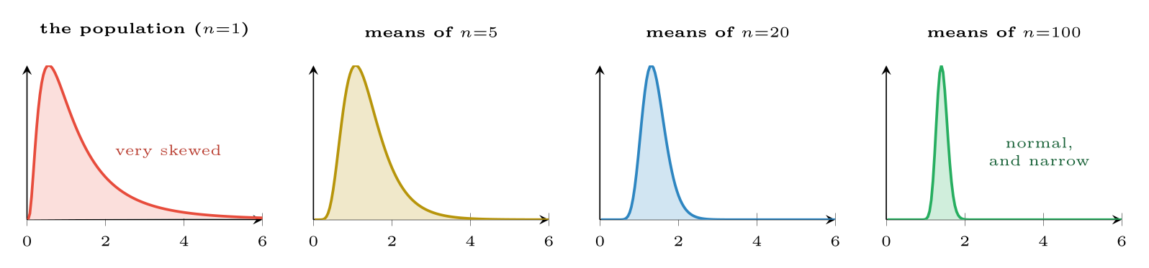
The Central Limit Theorem at work
FIGURE 6.3
The population (left) is heavily skewed, yet the distribution of sample means becomes normal and progressively narrower as n grows. The spread shrinks as σ/√n — quadrupling the sample halves the uncertainty.
Data Science · Chapter 6 · Probability and Uncertainty
§6.6 · Handout p. 38 25
Notes:
Figure 6.3 (handout p. 38): The Central Limit Theorem at work. The population (left) is heavily skewed, yet the distribution of sample means becomes normal and progressively narrower as n grows. The spread shrinks as σ/√n — quadrupling the sample halves the uncertainty.

Slide 26

Why the CLT Is the Most Useful Theorem in the Course
CONCEPT
It means you can put a confidence interval around an average, and run a hypothesis test, without knowing the shape of the underlying data. Response times are wildly skewed; the average of 200 response times is nevertheless approximately normal, so the standard tools apply. That is the entire licence on which Chapter 9 operates.
Note also the √n: to halve your uncertainty you need four times the data. This is why “just collect more data” has sharply diminishing returns, and why it is worth knowing before you promise a stakeholder anything.
Data Science · Chapter 6 · Probability and Uncertainty
§6.6 · Handout p. 38 26
Notes:
Read the box aloud, then ask for an example from the room before moving on.

Slide 27

Common pitfalls
COMMON PITFALLS
✕
Confusing P(A ∣ B) with P(B ∣ A). “99% of attacks trigger an alert” is not “99% of alerts are attacks”. See Figure 6.2.
✕
Multiplying probabilities that are not independent. Two sensors on the same power supply do not fail independently, so P(both fail) ≫ P(A)P(B).
✕
Applying the CLT to a single observation. The theorem is about the distribution of means, not of raw values. Individual response times stay skewed no matter how much data you collect.
Data Science · Chapter 6 · Probability and Uncertainty
§6.6 · Handout p. 38 27
Notes:
For each pitfall, ask who has seen it happen. One real story beats five bullets.

Slide 28





Four lenses: Conditional Probability and Base Rates
FOUR LENSES
LEARNING ANALYTICS
PROJECT MANAGEMENT
Only 8% of students eventually fail.
The prior probability that a randomly chosen project overruns is about 50% in many organisations — which is a high base rate, and therefore the opposite situation to security.
INTERNET OF THINGS
CYBERSECURITY
P(failure within 30 days) ≈ 0.002 for a given motor.
The worked example is this lens.
Data Science · Chapter 6 · Probability and Uncertainty
Handout p. 42 28
Notes:
The same method, four domains. Each of the next four slides opens one lens in full.

Slide 29

Learning Analytics: Conditional Probability and Base Rates
FOUR LENSES
LEARNING ANALYTICS
Project Management
Only 8% of students eventually fail. A model that flags at-risk students with a 10% false-positive rate will produce a flagged list that is mostly students who would have passed anyway. Before any outreach programme is designed, compute P(fails ∣ flagged) — because a list that is 70% wrong will destroy staff confidence in the system within a term, and may harm the students wrongly labelled (Chapter 28).
Internet of Things
Cybersecurity
Data Science · Chapter 6 · Probability and Uncertainty
Handout p. 42 29
Notes:
Learning Analytics. Only 8% of students eventually fail. A model that flags at-risk students with a 10% false-positive rate will produce a flagged list that is mostly students who would have passed anyway. Before any outreach programme is designed, compute P(fails ∣ flagged) — because a list that is 70% wrong will destroy staff confidence in the system within a term, and may harm the students wrongly labelled (Chapter 28).

Slide 30

Project Management: Conditional Probability and Base Rates
FOUR LENSES
PROJECT MANAGEMENT
Learning Analytics
The prior probability that a randomly chosen project overruns is about 50% in many organisations — which is a high base rate, and therefore the opposite situation to security. Here even a moderately accurate predictor produces alerts that are usually right, so the practical difficulty is not false alarms but persuading people to act on a warning they already half-expected.
Internet of Things
Cybersecurity
Data Science · Chapter 6 · Probability and Uncertainty
Handout p. 42 30
Notes:
Project Management. The prior probability that a randomly chosen project overruns is about 50% in many organisations — which is a high base rate, and therefore the opposite situation to security. Here even a moderately accurate predictor produces alerts that are usually right, so the practical difficulty is not false alarms but persuading people to act on a warning they already half-expected.

Slide 31

Internet of Things: Conditional Probability and Base Rates
FOUR LENSES
INTERNET OF THINGS
Learning Analytics
P(failure within 30 days) ≈ 0.002 for a given motor. This is a rare-event problem, so the base-rate arithmetic of Figure 6.2 applies directly: an 80%-detection, 2%-false-alarm model yields P(fail ∣ alert) ≈ 7%. Whether that is acceptable is an expected-value question — compare the cost of 13 unnecessary inspections against one unplanned line stoppage.
Project Management
Cybersecurity
Data Science · Chapter 6 · Probability and Uncertainty
Handout p. 42 31
Notes:
Internet of Things. P(failure within 30 days) ≈ 0.002 for a given motor. This is a rare-event problem, so the base-rate arithmetic of Figure 6.2 applies directly: an 80%-detection, 2%-false-alarm model yields P(fail ∣ alert) ≈ 7%. Whether that is acceptable is an expected-value question — compare the cost of 13 unnecessary inspections against one unplanned line stoppage.

Slide 32

Cybersecurity: Conditional Probability and Base Rates
FOUR LENSES
CYBERSECURITY
Learning Analytics
The worked example is this lens. Add to it: an adversary who knows your detector exists will deliberately operate just below its threshold, which changes P(alert ∣ attack) over time in a way no other domain in this course experiences. Base-rate arithmetic tells you today’s precision; Chapter 26 deals with the fact that tomorrow’s is being actively degraded.
Project Management
Internet of Things
Data Science · Chapter 6 · Probability and Uncertainty
Handout p. 42 32
Notes:
Cybersecurity. The worked example is this lens. Add to it: an adversary who knows your detector exists will deliberately operate just below its threshold, which changes P(alert ∣ attack) over time in a way no other domain in this course experiences. Base-rate arithmetic tells you today’s precision; Chapter 26 deals with the fact that tomorrow’s is being actively degraded.

Slide 33

Try it yourself: Simulating the Base-Rate Fallacy
TRY IT YOURSELF
Do not take the arithmetic on trust — generate a million sessions and count.
THIS WEEK'S LAB
WHAT YOU WILL RUN
RUNNABLE COPY
Week 3: Centre, spread, shape; base-rate simulation
1 listing, 20 lines of Python
code/ch06_base_rate.py
Data Science · Chapter 6 · Probability and Uncertainty
§6.6 · Handout p. 38 33
Notes:
Do not take the arithmetic on trust — generate a million sessions and count.

Slide 34
Simulating the Base-Rate Fallacy
LAB · STEP 1 OF 1
Set-up
Python · code/ch06_base_rate.py
1
2
3
4
5
6
7
8
9
10
11
12
13
14
15
16
17
18
19
20
import numpy as np
rng = np.random.default_rng(42)
N = 1_000_000
base_rate = 0.0001 # 1 in 10,000 sessions is an attack
detection = 0.99 # P(alert | attack)
false_alarm= 0.01 # P(alert | normal)
is_attack = rng.random(N) < base_rate
p_alert = np.where(is_attack, detection, false_alarm)
alert = rng.random(N) < p_alert
print("attacks :", is_attack.sum())
print("alerts raised :", alert.sum())
print("alerts that were real:", (alert & is_attack).sum())
print("P(attack | alert) :", (alert & is_attack).sum() / alert.sum())
# ~0.0098 -- matches the hand calculation
# Now set false_alarm = 0.0001 and re-run. Precision jumps to ~50%.
# Changing detection from 0.99 to 0.999 barely moves it at all.
Data Science · Chapter 6 · Probability and Uncertainty
§6.6 · Handout p. 38 34
Notes:
Step 1: Set-up. Read the code aloud; ask what each line would print before running it.

Slide 35
What the lab shows
TRY IT YOURSELF
The point of the last two lines: in rare-event detection, effort spent reducing false alarms is worth vastly more than effort spent raising the detection rate. That is a counter-intuitive engineering priority, and it falls straight out of Bayes’ theorem.
Data Science · Chapter 6 · Probability and Uncertainty
§6.6 · Handout p. 38 35
Notes:
Read the box aloud, then ask for an example from the room before moving on.

Slide 36

A test is 95% accurate for a condition affecting 1 in 1,000 people. Roughly what fraction of positive tests are correct — about 95%, about 50%, or about 2%? Justify without a calculator.
CHECKPOINT 1 OF 3
Discuss with the person next to you, then advance.
Data Science · Chapter 6 · Probability and Uncertainty
Handout p. 42 · answers in Appendix D 36
Notes:
Ask the room. Do not advance until someone commits to an answer.

Slide 37

A test is 95% accurate for a condition affecting 1 in 1,000 people. Roughly what fraction of positive tests are correct — about 95%, about 50%, or about 2%? Justify without a calculator.
CHECKPOINT 1 OF 3 · ANSWER
About 2%. Of 100,000 people, 100 have the condition and 95 test positive; 99,900 do not and about 4,995 test positive falsely. So 95/5090 ≈ 1.9%. This is the base-rate fallacy (Figure 6.2).
Data Science · Chapter 6 · Probability and Uncertainty
Handout p. 42 · answers in Appendix D 37
Notes:
Answer (Appendix D): About 2%. Of 100,000 people, 100 have the condition and 95 test positive; 99,900 do not and about 4,995 test positive falsely. So 95/5090 ≈ 1.9%. This is the base-rate fallacy (Figure 6.2).

Slide 38
Events A and B are mutually exclusive and both have probability 0.3. Are they independent? Show why.
CHECKPOINT 2 OF 3
Discuss with the person next to you, then advance.
Data Science · Chapter 6 · Probability and Uncertainty
Handout p. 42 · answers in Appendix D 38
Notes:
Ask the room. Do not advance until someone commits to an answer.

Slide 39
Events A and B are mutually exclusive and both have probability 0.3. Are they independent? Show why.
CHECKPOINT 2 OF 3 · ANSWER
No. Mutually exclusive means P(A∩ B)=0, but independence would require P(A)P(B)=0.09. Since 0 ≠ 0.09, they are strongly dependent.
Data Science · Chapter 6 · Probability and Uncertainty
Handout p. 42 · answers in Appendix D 39
Notes:
Answer (Appendix D): No. Mutually exclusive means P(A∩ B)=0, but independence would require P(A)P(B)=0.09. Since 0 ≠ 0.09, they are strongly dependent.

Slide 40
The CLT says the sample mean becomes normal as n grows. Does it say individual observations become normal?
CHECKPOINT 3 OF 3
Discuss with the person next to you, then advance.
Data Science · Chapter 6 · Probability and Uncertainty
Handout p. 42 · answers in Appendix D 40
Notes:
Ask the room. Do not advance until someone commits to an answer.

Slide 41
The CLT says the sample mean becomes normal as n grows. Does it say individual observations become normal?
CHECKPOINT 3 OF 3 · ANSWER
No. It concerns the distribution of sample means. Individual observations keep whatever distribution the population has, however large n becomes.
Data Science · Chapter 6 · Probability and Uncertainty
Handout p. 42 · answers in Appendix D 41
Notes:
Answer (Appendix D): No. It concerns the distribution of sample means. Individual observations keep whatever distribution the population has, however large n becomes.

Slide 42

What to take away
CHAPTER SUMMARY
1
Probability is how uncertainty is written down; every classifier output is a probability statement.
2
P(A ∩ B) = P(A)P(B) only under independence; the addition rule needs the overlap subtracted unless events are mutually exclusive.
3
Conditioning shrinks the sample space, which is why P(A ∣ B) and P(B ∣ A) differ.
4
Bayes’ theorem converts measurable likelihoods into the posterior you actually want. Under a low base rate, an excellent detector still produces mostly-wrong alerts.
5
Expected value turns model quality into a cost comparison a stakeholder can act on.
6
The CLT makes sample means normal regardless of the population’s shape, and uncertainty falls only as √n.
Data Science · Chapter 6 · Probability and Uncertainty
Handout p. 42 42
Notes:
Ask the room to say each takeaway before you reveal it.

Slide 43

Quick check 1 of 2
REVIEW · MULTIPLE CHOICE
P(A ∩ B) = P(A) × P(B) holds when A and B are:
A
mutually exclusive
B
independent
C
equally likely
D
always
Data Science · Chapter 6 · Probability and Uncertainty
Handout p. 42 43
Notes:
Take a show of hands for each option before discussing. (The handout does not print MCQ answers.)

Slide 44
Quick check 2 of 2
REVIEW · MULTIPLE CHOICE
As sample size quadruples, the standard deviation of the sample mean:
A
quadruples
B
doubles
C
halves
D
is unchanged
Data Science · Chapter 6 · Probability and Uncertainty
Handout p. 42 44
Notes:
Take a show of hands for each option before discussing. (The handout does not print MCQ answers.)

Slide 45
For your notebook
REVIEW QUESTIONS
SHORT
State Bayes’ theorem and name each of its four parts.
SHORT
Explain the base-rate fallacy to a non-technical manager in three sentences, without using a formula.
SHORT
Why are two sensors sharing a power supply not independent, and what does that do to your estimate of P(both fail)?
APPLIED
A plagiarism detector flags 90% of copied assignments and falsely flags 5% of honest ones. 2% of assignments are copied. For 10,000 submissions, build the full table of counts and compute P(copied ∣ flagged). Comment on whether this detector should be used to open disciplinary proceedings automatically.
APPLIED
Using expected value, decide whether to investigate alerts from a detector with P(attack ∣ alert) = 0.004, where investigation costs 30 minutes and a missed attack costs 60 hours. Show the calculation and state the break-even precision.
Data Science · Chapter 6 · Probability and Uncertainty
Handout p. 42 45
Notes:
Set these for independent study. Model answers are not printed in the handout.

Slide 46
End of Chapter 6
06
NEXT
READ
Chapter 7 — Acquisition, Wrangling and Cleaning
Handout Chapter 6, pages 35–42
THIS WEEK'S LAB
ASSESSMENT
Centre, spread, shape; base-rate simulation
Quiz 1 (Ch 1–4)
Data Science · Chapter 6 · Probability and Uncertainty
46
Notes:
Close. NEXT: Chapter 7 — Acquisition, Wrangling and Cleaning. READ: Handout Chapter 6, pages 35–42. THIS WEEK'S LAB: Centre, spread, shape; base-rate simulation. ASSESSMENT: Quiz 1 (Ch 1–4).

